Slide 1
SERVITIZATION AND INNOVATION
Author: Slovak Business Agency

Slide 2
Objectives & Learning Outcomes
Completion of the module will enable you to:
Understand the servitization and innovation process
Learn about tools and methods that support servitization and innovation process
Learn about good practices/case studies
Identify business opportunities arising from new technologies and principles

Slide 3
Content
Servitization and Innovation
What is Servitization
What is Innovation

Slide 4
What is servitization?

Slide 5
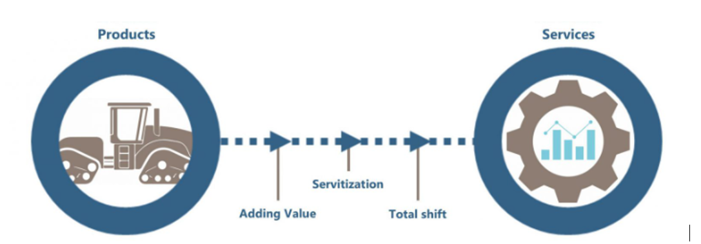
Definition & key aspects
Transformational process of shifting from a product-centric business model and logic to a service-centric approach´ (C. Kowalkowski et al., 2017).
Growing importance of services service becomes a crucial factor in servitization process.
Product ﬁrms, manufacturers, but also companies from the service sector can servitize.
Example: Apple
iCloud where users can store data, photos, and backups paying for storage on a subscription basis.
AppleCare providing extended warranty and support services, ensuring customers have access to technical support and repairs.

Slide 6
Before implementation
Is servitization suitable for your business?
Consider if you are able to reach following goals:
Building a company vision focused on selling service.
Offering customers targeted and extraordinary experience.
Understanding customers' needs over solely focusing on the features of a product.

Slide 7
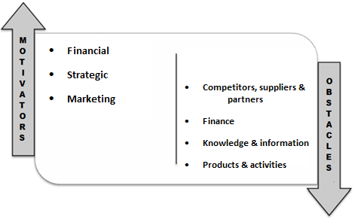
Before implementation
Pros and cons
Challenges in guaranteeing coordination and collaboration among various actors of a competitive environment.
Higher levels of profitability and stability of income in long term.
Acquisition of the competitive advantage and use of services to differentiate offers and create valuable competitive opportunities.
Financial resources in the beginning of the process, unexpected costs if the service strategy is not well understood or considered.
Boosting/enhancing product sales by adopting services (services play a crucial role in fostering customer loyalty by encouraging repeat purchases and provides opportunities for increased interaction with customers).
Building trust of customers to ensues their understanding of services´ added value .
Additional workforce (more expensive than products manufacturing).

Slide 8
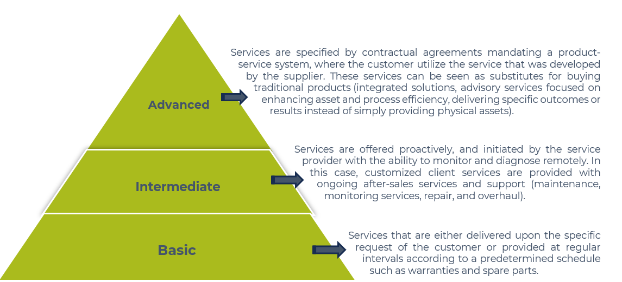
Levels of servitization

Slide 9
Methodology for the implementation
Service Innovation Methodology developed under THINGS+ project
Use the Product Attributes Map,
Elaborate the Value Proposition Canvas, Value Map,
Use Jobs To Be Done theory
Compare the competitors´ solutions
Phase 2:
Comprehensive understanding of the customers and their needs
Phase 4:
Implementation strategy and commercialisation of the servitized product
Use the Business Model Canvas
Use Resources Processes and Values Framework
Phase 5:
International expansion
Phase 1:
Servitization opportunities
Create a customer persona
Create the Customer Journey
Develop the servitization concept
Phase 3:
Servitization project and possible challenges
Prepare a short strategy plan (One Page Strategy)
Prepare the List of Assumptions

Slide 10
Digital servitization
Comprehensive system integrating both servitization and software systems.
Servitization
Digital technologies
Digital servitization
Digitalization
Helps make products and services more service-oriented by incorporating digital elements, which improves the overall user experience
Supports servitization by integrating advanced digital features into products, which allows companies to offer more sophisticated and efficient services to their customers
By digitizing certain features, digitalization reduces the physical nature of an offering (digital parking solutions transform traditional manual parking spaces as cameras scan vehicle licence plates, and parking fees are charged electronically or service platform that can servitize existing offerings as the hotel service replacement by the service platform AirBnB)
Tip: Software Servitly enables you to build and configure all the software components needed to support new product-service offerings. This is your DPS (Digital Product-Service) system.

Slide 11
What is Innovation?

Slide 12
Definition
Innovation is ´The successful development and application of new knowledge´. (OECD)
Innovation isn't limited to products, it can also involve developing new services, business models, processes, and functions.
Starbucks uses its own unique terminology for cup sizes like grande and venti, instead of the usual small, medium, and large. Additionally, they have developed their own payment app.

Slide 13
Types of innovation
Various types of innovation can be recognized based on their scale or intensity, influence on markets and value chains:
Process innovation
Product innovation
Sustaining innovations
Disruptive innovations
Enhancement of production technologies or new improved methods of supplying services and delivering products that can lead to cost reductions.
It involves rethinking and redesigning the workflows, procedures, and methods used within an organisation.
Starbucks: seamless and customer-oriented ordering and order fulfilment process; using the modern digital technologies, mobile ordering systems that allow customers to conveniently place orders and pay via smartphones.
Introducing new products to market or enhancing existing ones, which involves modifying their features or attributes
IKEA: selling innovative products in flat-pack format, which improves purchasing and its logistics for customers.
Preserves the level of improvement in features adding value to products.
Regular updates to smartphone models with improved camera features and processing speed
Unpredictable improvements bringing significant, unforeseen changes to the markets that appear irregularly.
It involves innovations and technologies that help make high-cost or complex products and services affordable and accessible to a broader market
Netflix; introduction of digital music downloads

Slide 14
Prepare for your innovation journey
Key preparatory steps for innovation initiatives:
Define what innovation means and ensure it is understood in the same way within your company.
Set concrete objectives for innovation you would like to introduce into your company, which can be measured and reached.
Pay attention to diversity when it comes to forming a team. Build a team consisting of members with various skills and backgrounds that can provide different perspectives as it leads to more comprehensive and effective solutions driving innovation. Create teams that encompass members from diverse departments within the organisation to foster collaboration and profit from a variety of expertise to achieve common goals and innovation outcomes.
Allocate an appropriate amount of funds to cover various stages and aspects of the innovation process, including research, development, and implementation.

Slide 15
Innovation process & its phases
The innovation process is a structured and carefully managed sequence of strategic actions accompanied by the application of creative and novel approaches. It involves introducing innovative methods, exploring different sources of supply, entering new markets, developing.
Actively search for new and revolutionary concepts and ideas that could contribute to the redefinition of products, services, or processes
You can use Design Thinking or Creativity Techniques (brainstorming sessions, mind mapping).
Phase 2:
Advocacy screening and experimentation
Phase 4:
Marketing and commercialization
Create solution-building prototypes and conduct various tests.
Transform the idea into a concrete solution.
Introduce and spread the idea within the market. Turn the innovative idea into concrete, practical real-world application. Evaluate the innovation's effect on customer requirements, establish criteria for measuring success, and gather valuable feedback to drive ongoing enhancements.
Provide an in-depth analysis, gain information for evaluating feasibility, and explore the potential problems and benefits of the business idea.
Analyse the customer needs and ensure that the innovation aligns with real-world requirements.
Produce market value for the created solution. Establish detailed specifications for the idea that are clear and closely aligned with the requirements of the market. Ensure that the developed product or service effectively addresses market needs, increasing its chances of success and creating value for customers.
Phase 3:
Preparing a solution
Phase 1:
Innovative idea creation
Phase 5
Expansion and implementation

Slide 16
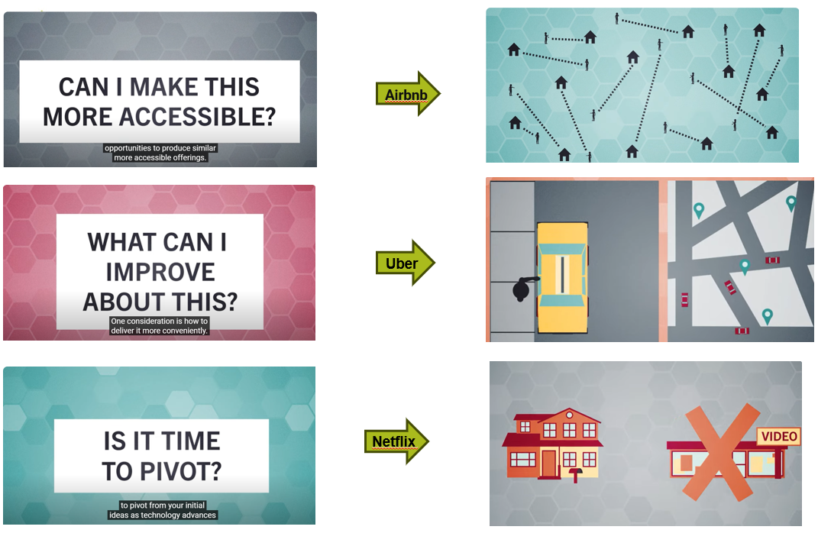
Innovation process & its phases
You can check mentioned questions that can help you on your innovation journey and see the examples of innovative ideas.
Get inspiration on how to come up with innovative business ideas in this video.

Slide 17
How to boost the innovation process
Open innovation
Helps companies to enhance its innovation process by sourcing ideas both internally and externally
Can help organisations discover new ways to solve problems and challenges while also building a positive reputation even during the crises as COVID-19
Can serve as a foundation for future collaboration
LEGO’s open innovation approach through the LEGO Ideas platform where a community of fans and enthusiasts can submit their own ideas for new products allows the company to crowdsource product ideas while strengthening its relationship with a dedicated customer base.

Slide 18
How to boost the innovation process
How to apply open innovation in your organization?
Hackathon
Event where people from various fields come together to address specific challenges by developing solutions within a set time frame.
Events can range in duration, typically lasting from one day to a week, but can also extend over several weeks, especially in an online format.
You can organise a hackathon as an internal or external event.
An internal hackathon is exclusively for the employees of the company or organisation hosting the event.
During the external hackathon the company invites external experts to participate in a competition to solve a specific problem.
The challenges in these hackathons often relate to marketing strategy issues or product innovation.

Slide 19
How to boost the innovation process
How to organise a hackathon?
Select a project to be solved by the participants/present the project to be prototyped.
Clearly explain the assignment to ensure everyone understands the goal of the event.
Analyse the solutions. (Make a critical decision on whether to continue with the project and, if so, laying out a clear plan for how to proceed.)
Form teams and divide the roles within each team.
Create a task list and a solution procedure. (Ensure the task list keeps each team member engaged during the event while tasks assigned to one member should last no more than 2-3 hours.)
Code, design and prototype.
Continuously update and refine solutions.
Present the results.
Eat and sleep.

Slide 20
How to boost the innovation process
Tip: You can use a new tool aimed at assisting company leaders in optimising their allocation of resources toward innovation initiatives.
It consists of two parts: a strategy summary framework and an innovation basket. Leaders begin by defining and understanding the strategy of their unit or organisation and identifying what changes are necessary to achieve it. The identified change needs are then converted into specific innovation objectives and leaders establish their ´innovation basket´ by mapping out each project against these objectives. It helps to exclude projects that are not aligned with the objectives and create new ones that are aligned.

Slide 21
Benefits & Challenges
Innovation can impact your organisation in a positive way as you can:
Get a competitive advantage.
Better address a customers’ needs which enables you to attract new customers and maintain existing ones.
Identify new opportunities for your company, increase its revenue, expand market share, and enhance its overall success.
Enhance the effectiveness and productivity of your company.
Be more prepared to handle changes.
Attract and maintain skilled professionals and talented employees.
Build sustainable practices and resilience to actively encourage and support the ability of your business to withstand challenges and maintain its operations over time.
Innovation involves experimentation, trying new approaches, and taking risks in order to push boundaries and achieve progress. Therefore, it is absolutely natural that some mistakes and failures may occur along the way.
Failure of an innovation - new technology concept, or product upon market introduction. Smaller-scale tests and launching prototypes that enable post-trial adjustments before mass production are recommended.
Financial difficulties or constraints as companies allocate resources to support innovations without seeing immediate profits. Expected profit should be evaluated and innovation should be in line with the company's long-term goals.
Innovation fails to resonate with customer needs and preferences, resulting in poor performance or lack of success in the market. Before investing in innovations, conducting market research is necessary.
Capacity lack of implementation when searching for strategic partnerships may help.
Challenges arising within the company's structure and operations following the launch of innovation connected with the possibility of allocating excessive resources to innovation. Therefore, effective planning and resource distribution by top management are crucial.
Unforeseen challenges that arise based on external factors. Therefore, having a contingency plan that helps to overcome these challenges is important.

Slide 22
Innovation and resilience
Organisations can enhance their capacity for resilience by effectively managing innovation.
Innovation resilience refers to how well an organisation can handle the uncertainties that arise during its innovation process by adapting both stability and adaptability playing an essential role as key elements.
Example:
Huawei established a special self-critical system known as the Red and Blue Army. The Red Army represents the existing strategic plans and approaches of the company. On the other hand, Blue Army embodies an innovative strategic model or strategy model adapted by competitors. The main responsibility of the Blue Army is to offer alternative perspectives, identify potential issues, and even provide warnings. This confrontative system enables the company's management to get a variety of valuable recommendations. Thanks to this approach, the company can make informed decisions and steer innovation initiatives toward success.
Tip: Find useful tips and suggestions on how to increase innovation resilience in your innovation team here.

Slide 23
Female entrepreneurship and innovation
Women generally possess significant levels of creativity and innovative capabilities. Therefore, women entrepreneurs can achieve great results when it comes to innovations. However, sectors where women are predominantly active typically lack high-tech innovations.
Women are usually excluded from participating in networks focused on technological innovation and they are commonly perceived as passive participants who merely use or receive innovations, rather than being recognized as innovators.
Examples
Estée Lauder with her innovative approach towards the sale of her cosmetic products;
Ninna Granucci, winner of the Prize for Women Innovators for an innovative fermentation process transforming food and vegetable by-products generated by the food processing industry into valuable food ingredients.

Slide 24
What to remember

Slide 25
What is Servitization
Servitization is the transformational process of shifting from a product-centric business model and logic to a service-centric approach. It means that in the servitization process, service becomes a crucial factor.
Servitization is not just for product ﬁrms or manufacturers.
Service Innovation Methodology can help you to implement servitization in 5 phases.
Based on different factors as, for example, technology used and product type, we can recognize 3 levels of servitization: basic, intermediate and advanced. The different levels refer to the varying degrees to which a product can be enhanced with these services.
What is Innovation
Innovation involves the development and implementation of new ideas, methods, or processes that bring positive change, increased productivity or value creation.
There are various types of innovation based on scale or intensity, value chains, and influence on markets.
Innovation involves experimentation, trying new approaches. Therefore, it is natural if you experience failure during the innovation process.
To boost the innovation process in your company, you can use various methods, for example open innovation and hackathon.

Slide 26
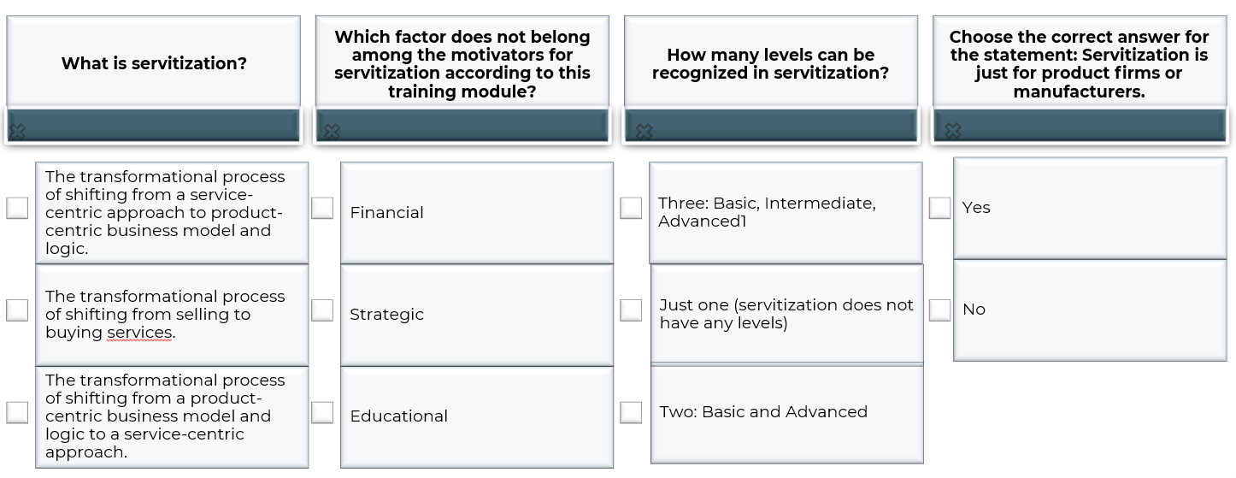
Self-assessment test

Slide 27
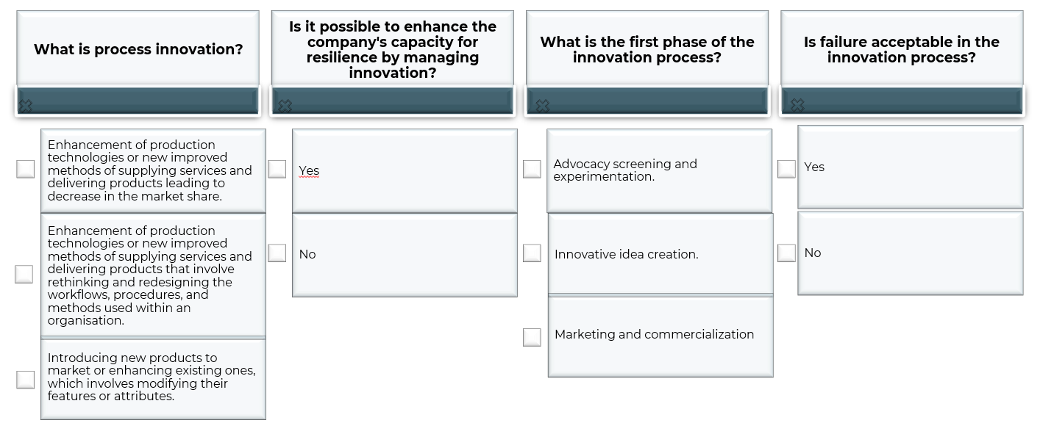
Self-assessment test

Slide 28
Self-assessment test - correct answers

Slide 29
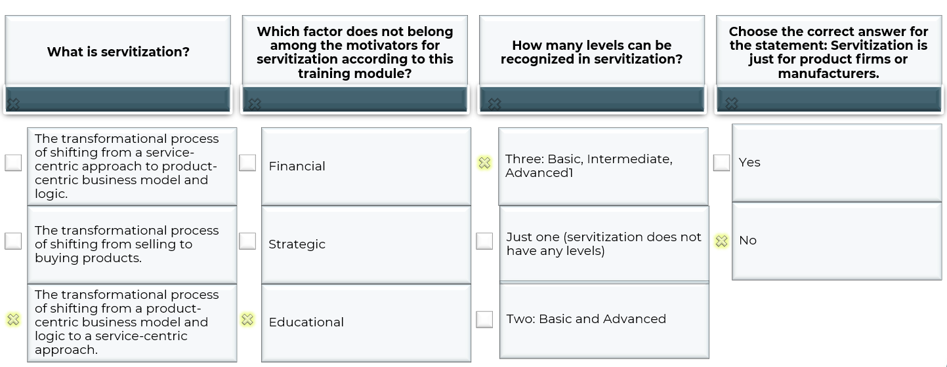
Self-assessment test

Slide 30
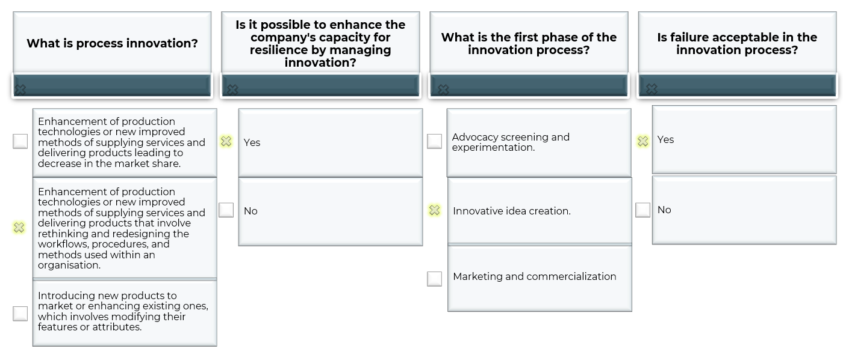
Self-assessment test

Slide 31
Thank you for your attention!

