Slide 1
Module 5
Gender implications of entrepreneurship
Personal Resilience and Well-being
Author: HÉTFA Research Institute & SEED Foundation

Slide 2
Objectives & Learning Outcomes
Completion of the module will enable you to:
Learn on the key challenges women entrepreneurs face
Recognize the individual, organizational and socio-economic factors affecting women’s entrepreneurial opportunities.
Learn strategies to overcome difficulties in your entrepreneurial journey and meet with successful women entrepreneurs through motivational videos
define resilience, assess own resilience levels, and identify key resilience traits like flexibility, adaptability, and emotional regulation for use in challenging situations.
manage energy and foster long-term well-being
set specific resilience goals, identify strengths and areas for improvement, and create a structured plan to better cope with challenges, using your social support network.
Notes:
közös

Slide 3
Subtopic 1
Gender implications of entrepreneurship

Slide 4
Content
Gender implications of entrepreneurship
Factors impacting entrepreneurial opportunities
Introduction
Gender equality in entrepreneurship
Key challenges in entrepreneurship for Women
Strategies
Notes:
Csenge

Slide 5
3.1.1 Introduction
Despite their underrepresentation in entrepreneurship, women have significant potential to drive economic prosperity, foster innovation, and enhance societal welfare. Empowering women entrepreneurs, however, not only contributes to greater economic growth, societal advancement, and sustainable development, but serves as a catalyst for women's own economic development in many ways:
Women can gain economic independence through entrepreneurship, it can foster their financial self-sufficiency and strengthen their economic position.
Women entrepreneurs create job opportunities, contributing to the reduction of unemployment.
Women-owned businesses drive economic progress by introducing innovative ideas, often tailored to meet the specific needs of women.
By becoming entrepreneurs, women can lift themselves and others out of poverty, contributing to overall social welfare.
Women entrepreneurs face challenges such as limited access to finance, cultural barriers, and regulations, but overcoming these hurdles can unlock further economic benefits for them and society.
Building networks and gaining social support can help women overcome challenges like lack of information, training gaps, and competing responsibilities at home and work.

Slide 6
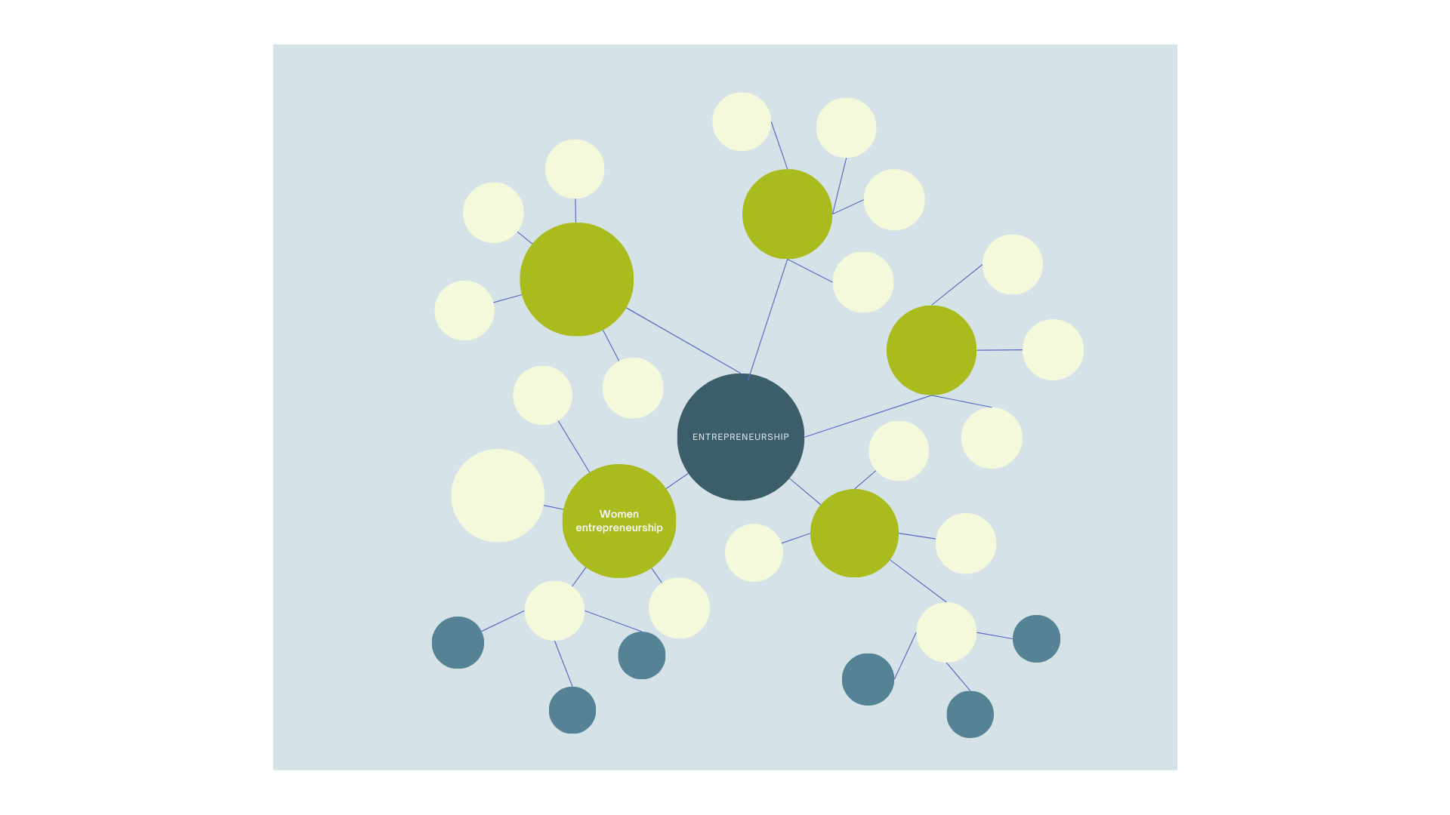
EXERCISE – Gender roles and expectations
Make a mind map! Write down anything you associate with being an 'entrepreneur' and a 'woman entrepreneur.’
Answer the following questions based on the mind map you created!
What differences do you observe between ‘entrepreneur’ and ‘women entrepreneurs’?
What do you believe are the reasons behind these differences?
Do you observe expectations connected with women entrepreneurs?
How do these expectations impact the success and fulfilment of women entrepreneurs?
Notes:
Mesi

Slide 7
3.1.2 Gender equality in entrepreneurship
Women entrepreneurs face gender-specific challenges. Let's take a look at the challenges and explore what strategies you as a woman and an entrepreneur can use to overcome them.
Gender Inequality: Systemic disadvantages women face.
Gender inequality in entrepreneurship refers to the unequal opportunities, resources, and treatment women face compared to men when starting and running businesses. These inequalities stem from financial, societal, and cultural barriers that disproportionately affect women.
Gender Equality: Equal access to rights and opportunities regardless of gender.
Equal enjoyment of rights and access to opportunity and resources for everyone independent of gender, age, ethnicity, religion, sexual orientation, resources for living, etc. Equality refers to a qualitative aspect: priorities and needs have to be taken into consideration when addressing the equality of a particular group. So, equality does not mean that women and men are the same or have to be the same, instead diversity of different groups of women and men are acknowledged in order to ensure the same rights and access to opportunities, resources. In short, gender equality means that both women and men are able to enjoy human rights, the same opportunities and resources and potential to contribute or benefit from society, economy, social and cultural goods.
Visit this glossary on gender equality and read the definitions of gender equality and gender equity.

Slide 8
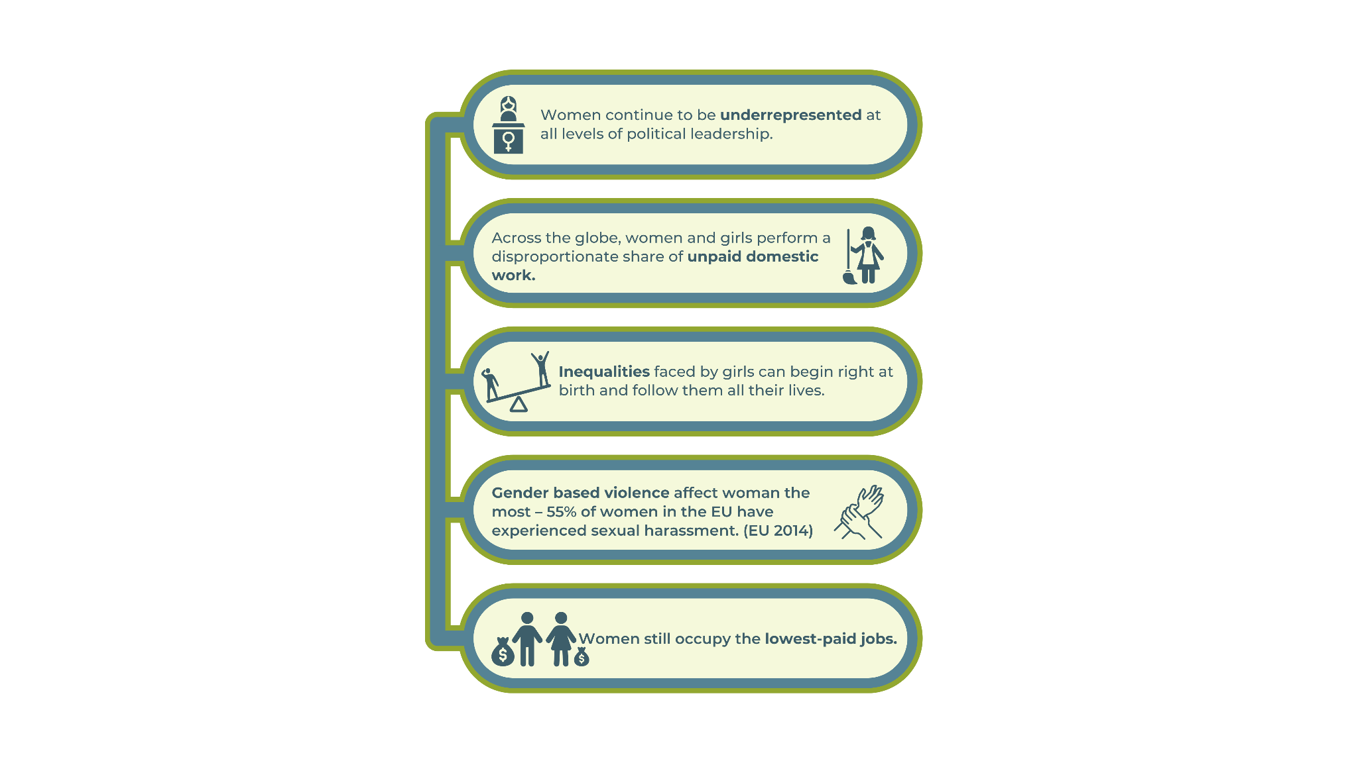
3.1.2 Gender equality in entrepreneurship
The Gender Gap
The difference in any area between women and men (i.e.: power, rights, resources, participation, remuneration, benefits). Gender pay gap is the most well-known, worldwide measured gap, it describes the difference between the average earnings of men and women.

Slide 9
3.1.2 Gender equality in entrepreneurship
Exercise 1 Check the latest Global Gender Gap Report 2023. Reflect on how gender gaps in your country impact women entrepreneurs.
Exercise 2
Examples for gender gap in entrepreneurship
Women represent 1/3 of the entrepreneurs, they constitute 28-34% of all the entrepreneurs
There is an increase since 2008 in regards of the number of women starting businesses
Women tend to own small businesses (one-person enterprises in the EU (78%), be rather freelancers, or operate in smaller companies as entrepreneurs, but this is also changing: more women work at larger companies than before
Women have less access to gaining capital and less access to have information
Main areas to set up businesses are: health, social-work activities, services or education
Women are underrepresented in creating innovative enterprises
From the start-ups, about 15% of the founders are women
In the ICT sector: women are progressing to participate in as entrepreneurs, but they are still very behind of men, women are usually employed as managers and professionals in ICT, but more and more women occupy technical positions
There is still less investment in women entrepreneurships
Women bear greater domestic and childcare responsibilities than men (all over the world)
Do any of these sound familiar to you? Do you feel affected by them?

Slide 10
3.1.2 Gender equality in entrepreneurship
Reflecting on Gender Equality in Your Country
Can you identify and describe examples of gender inequality in your country or community? Consider aspects such as employment, education, and social roles.
In your country, what are examples that show women do not share equal status with men in different spheres of society?
What are the consequences of these inequalities for nations or countries?
Consider the impact of gender inequality on entrepreneurship: How do you think gender inequalities affect your opportunities and challenges as an entrepreneur? How do these inequalities impact entrepreneurship and women's ability to run businesses?
In your country, do you think men and women have equal access to starting a business? Why or why not? List potential consequences and explain how they might influence your business journey.

Slide 11
3.1.3 Key challenges in entrepreneurship for women
Exercise
Do you agree with this statement?
Women have the same chances as men to start a business.
Social expectations and prejudices continue to hinder women from becoming entrepreneurs compared to men.
When women start a business, they have fewer financial assets.
What do you think?
Do others feel the same way about these issues?
What misconceptions might arise in these topics?

Slide 12
3.1.3 Key challenges in entrepreneurship for women
1. The Impact of Care Work on Women Entrepreneurs Care work refers to both unpaid and paid labour related to caregiving, such as taking care of children, the elderly, or household tasks. On one hand, many women become self-employed to achieve a better work-life balance and use entrepreneurship to manage childcare and eldercare while maintaining flexibility in their careers. On the other hand, women perform the majority of unpaid care work globally, which limits their ability to participate fully in the workforce:
The "double burden" of work and family responsibilities affects women disproportionately. Women often struggle to balance care work and entrepreneurship, which can lead to fewer business opportunities or slower business growth.
Reflection
How can entrepreneurship help women achieve a better balance between work and family life?
How does the responsibility of care work in your life impact your ability to pursue entrepreneurship?
Take action! Consider setting up flexible working structures and exploring the possibility of shared responsibilities at home.

Slide 13
3.1.3 Key challenges in entrepreneurship for women
2. Gender Inequality in Access to Finance and Capital
Women entrepreneurs often have less access to credit, finance, and capital compared to men:
Women typically own fewer financial assets (such as property).
Women have shorter credit histories and lower income levels.
Financial products are not always designed with women’s needs in mind.
Reflection Why do you think women-owned businesses receive less venture capital compared to men?

Slide 14
3.1.3 Key challenges in entrepreneurship for women
3. Challenges in Networking Opportunities
Networking is critical for entrepreneurial success, yet women often have fewer opportunities to access influential networks:
Women tend to network in smaller, often women-only circles.
Time constraints due to the double burden of home and work responsibilities limit networking opportunities.
Lower visibility of successful female role models in entrepreneurship.
Reflection
How can building strong networks help women entrepreneurs succeed in male-dominated industries?
Take action! Explore local and international women-only networks, or create your own to foster support and knowledge sharing.

Slide 15
3.1.3 Key challenges in entrepreneurship for women
4. Horizontal Gender Segregation in Business Sectors
Women entrepreneurs are concentrated in lower-growth sectors (e.g., retail, education, social work), while men dominate high-growth, innovative sectors (e.g., technology, engineering). Among the causes are:
Women’s self-employment often reflects labour market segregation, where women are pushed into less profitable industries.
Only a small percentage (between 5% and 15%) of women own businesses in science and technology.
Reflection
What steps can women take to break into high-growth industries like technology and engineering?

Slide 16
3.1.3 Key challenges in entrepreneurship for women
5. Prejudices and Stereotypes About Women in Business
Women entrepreneurs face stereotypes and biases that limit their opportunities and confidence. Examples of Bias:
Entrepreneurship is traditionally seen as a masculine field, reinforced by media and cultural narratives.
Stereotypes suggest that women-owned businesses are less innovative and risk-averse.
Women have fewer female entrepreneurial role models in high-growth sectors.
Exercise
What do you think? What are the institutional systems that maintain and reinforce gender stereotypes? List a few of them! Think of the family, education, workplaces, media, etc.
Choose one (or more) from the ones you listed! What stereotyped practices, behaviours and policies characterise this institution? How can it maintain and reinforce gender stereotypes?
What changes do you think are needed in the institution to initiate progress towards a gender-equitable society?
Reflection
What can be done to counter the stereotypes surrounding women entrepreneurs?
Take action!
Promote your own achievements!
Challenge these biases by showcasing successful women entrepreneurs and promoting gender-neutral entrepreneurial education.

Slide 17
3.1.4 Factors impacting entrepreneurial opportunities
Individual level
socialization, attitudes and motivations on career, education, family background
Organizational level
organizational norms, culture or programs of a given organization, structure of promotion, recruitment, performance evaluation, flexibility, trainings
gender is one of the fundamental organizing principles of social relations
work organizations are such places where gender is enacted and organized around shared practical understanding of its performance.
career development is embedded in organizational context: organizational processes underline and reinforce differences and shape gendering processes of identities, power relations, opportunities
Socio-economic macro level
social policy, states subsides, norms in society, structure of labour market

Slide 18
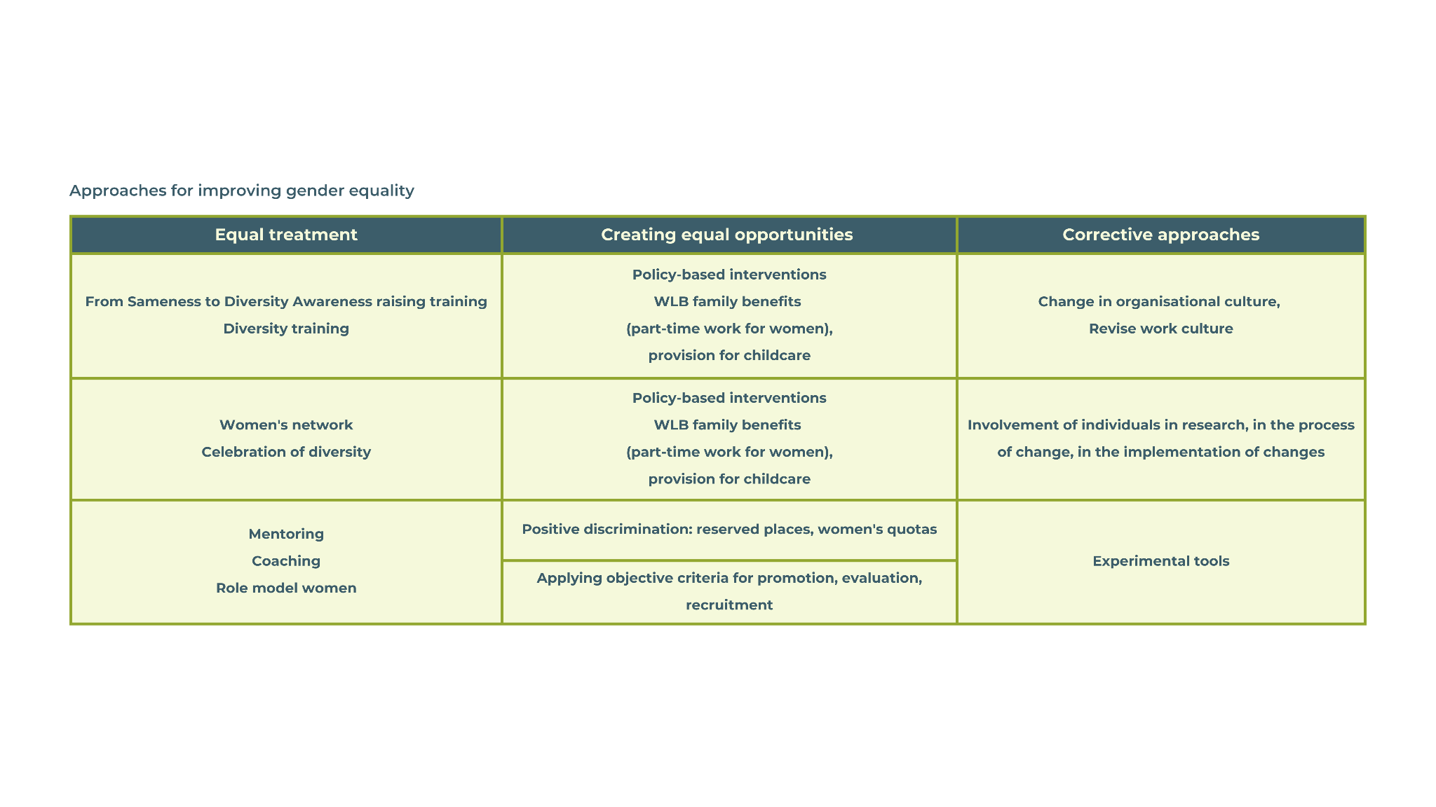
3.1.4 Strategies for overcoming gender-specific challenges in entrepreneurship

Slide 19
3.1.4 Strategies for overcoming gender-specific challenges in entrepreneurship
Reflections
What are some ways women can gain better access to finance and capital?
How can governments and institutions better support women in entrepreneurship?
What policy changes do you think could help reduce gender inequality in entrepreneurship in your country?
What changes can you implement in your business approach to overcome some of the barriers presented above?

Slide 20
3.1.4 Strategies for overcoming gender-specific challenges in entrepreneurship
3 strategies for overcoming gender-specific challenges in entrepreneurship
Building Networks
Join women entrepreneur groups or local business associations to gain support and share knowledge!
Take action! Can you identify three women entrepreneurs or business support networks in your area?
Accessing Financial Resources
Seek out grants, loans, and venture capital specifically designed for women-owned businesses. There are often programs that aim to close the funding gap.
Take action! Research funding opportunities available for women entrepreneurs in your region.
Advocacy and Policy Engagement
Advocate for policies that support gender equality in entrepreneurship, such as equal access to finance, childcare, and legal protections.
Final Question: What actions will you take next to strengthen your entrepreneurial journey? List at least 5 of them!

Slide 21
Subtopic 2.
3.2 Personal resilience and well-being

Slide 22
3.2.1 INTRODUCTION
The Resilience and Wellbeing module is structured to provide a step-by-step approach to understanding, assessing, and strengthening resilience, with a focus on enhancing overall well-being. Through carefully designed exercises, participants will develop a deep knowledge of resilience.
This module includes practical exercises such as self-assessments, inventory of resilience traits, and strategies to manage energy effectively. Participants will also engage in activities designed to boost confidence, such as learning new skills, processing best practices, and crafting a personalised Resilience Action Plan. The combination of these elements will empower you to thrive, even in challenging situations, and foster long-term personal and professional growth.

Slide 23
Content
Personal Resilience and Well-being
Factors impacting entrepreneurial opportunities
Introduction
What is resilience?
Assess your own resilience
Boost your resilience and shine with confidence
Resilience action plan
Notes:
Csenge

Slide 24
3.2.2. EMPOWERING WOMEN ENTREPRENEURS: BUILDING RESILIENCE

Slide 25
DEFINITION: Resilience is the capacity to recover from adversity, adapt to change, and face challenges with determination. It encompasses the ability to maintain flexibility in difficult situations, foster strong social support networks, and engage in self-reflection to grow from experiences. Resilience is not an inherent trait, but a skill that can be cultivated over time through practice and persistence. By developing resilience, individuals are better equipped to handle setbacks, stay focused on long-term goals, and continue progressing despite the obstacles they encounter.
IMPORTANCE: Resilience is a vital attribute for personal and professional success because it equips individuals with the mental and emotional strength to navigate challenges, setbacks, and adversity. In today’s fast-paced, unpredictable environment, resilience allows people to stay focused on their goals, manage stress effectively, and remain adaptable to changing circumstances. Without resilience, even minor challenges can feel overwhelming, leading to burnout, frustration, or giving up.

Slide 26
Traits that foster resilience
FLEXIBILITY: is the ability to adapt to changing circumstances, remain open to new ideas and strategies. It’s a critical trait for entrepreneurs, enabling them to respond to unexpected challenges.
Example: Judit Polgár – as one of the greatest female chess players, Judit faced and overcame the challenge of being a woman in a male-dominated sport. Her ability to adapt her strategies and continuously improve her game is a testament to her resilience and flexibility.
You can read more about: Judit Polgár - Wikipedia
ADAPTABILITY: is the ability to adjust your thoughts, behaviors, and strategies in response to changing conditions.
Example: Mária Telkes – known as the "Sun Queen," she was a Hungarian-American scientist who faced numerous challenges in her career, particularly in the male-dominated field of science. Despite these obstacles, she adapted her research and focus to continue innovating in solar energy technology. Her adaptability was key to her success in developing solar-powered devices, including the first solar-heated house.
You can read more about: Mária Telkes - Wikipedia

Slide 27
Traits that foster resilience
PERSEVERANCE plays a crucial role in achieving long term goals, helps individuals push through difficult situations and keep moving forward. Fosters resilience, as repeatedly facing challenges and persisting through them builds mental toughness.
Example: Katherine Johnson was a pioneering African American mathematician and physicist who made significant contributions to NASA's space exploration efforts. She is best known for her role in performing complex calculations that enabled the United States to successfully send astronauts into space and return them safely. One of her most famous achievements is when astronaut John Glenn specifically requested that Katherine Johnson verify the electronic calculations for his orbital flight around Earth. Glenn’s confidence in her abilities speaks to her expertise, as this flight was a key moment in the Space Race.
You can read more about: Katherine Johnson - Wikipedia
Watch the inspiring movie about her carrier: Hidden Figures - Wikipedia
FURTHER TRAITS that foster resilience:
Optimism, Problem-Solving Skills, Self-Reflection, Optimism, Gratitude,, Emotional Regulation, Physical Well-being… and many others.

Slide 28
Conclusion and takeaways
Recap: Resilience involves the ability to bounce back from adversity, remain flexible in the face of change, and confront challenges directly. Key components of resilience include building strong social support networks, cultivating adaptability, and engaging in regular self-reflection. These qualities allow individuals to manage setbacks more effectively and continue progressing toward their goals despite obstacles.
Encouragement: As an entrepreneur, integrating these principles into your journey will help you navigate the inevitable ups and downs of business life. By embracing resilience, you can face challenges head-on, adapt to shifting circumstances, and leverage your support network for guidance and encouragement. In doing so, you'll create a solid foundation for long-term success.
Final Thoughts: Resilience is not just a fixed trait, but a skill that can be nurtured and strengthened with consistent practice. Over time, you can develop the mental and emotional fortitude needed to overcome difficulties and persevere, ensuring that you remain on course toward achieving your entrepreneurial aspirations.

Slide 29
3.2.3. Assess your own resilience

Slide 30
EXERCISE: Resilience self-assessment- TEST
To begin the development process, it is important to assess your current situation. Understanding your level of resilience will help guide your personal growth and highlight areas for improvement. Please respond to each item of the Brief Resilience Scale (BRS) by marking one box per row. Your responses should reflect your current state, not what would be ideal. Remember, there are no wrong answers—this is simply a tool to help you understand where you are right now on your resilience journey.
 |  | Strongly disagree (1) | Disagree (2) | Neutral (3) | Agree (4) | Strongly agree (5)
1. | I tend to bounce back quickly after hard times | 1 | 2 | 3 | 4 | 5
2. | I have a hard time making it through stressful events | 1 | 2 | 3 | 4 | 5
3. | It does not take me long to recover from a stressful event | 1 | 2 | 3 | 4 | 5
4. | It is hard for me to snap back when something bad happens | 1 | 2 | 3 | 4 | 5
5. | I usually come through difficult times with little trouble | 1 | 2 | 3 | 4 | 5
6. | I tend to take a long time to get over set-backs of my life | 1 | 2 | 3 | 4 | 5

Slide 31
EXERCISE: Resilience self-assessment-SCORING
Scoring the Brief Resilience Scale (BRS)
Add the scores for each of the six questions and divide by six to determine the overall BRS score:
TOTAL SCORE /6 = OWN BRS SCORE
BRS SCORE INTERPRETATION:
1,00-2,99 – LOW RESILIENCE
3,00-4,30 – NORMAL RESILIENCE
4,31- 5,00 – HIGH RESILIENCE
SOURCE: Smith, B. W., Dalen, J., Wiggins, K., Tooley, E., Christopher, P., & Bernard, J. (2008). The brief resilience scale: assessing the ability to bounce back. International journal of behavioral medicine, 15(3), 194-200.

Slide 32
EXERCISE: Resilience self-assessment
Reflection
After completing the Brief Resilience Scale (BRS), take a moment to reflect on your responses and overall resilience level by considering the following questions:
How do you typically respond to stressful or challenging situations, and what patterns do you notice in how quickly you recover?
What coping strategies or habits have you found effective in stressful situations, and are there any areas where you could improve?
What specific actions or changes can you implement to strengthen your resilience and enhance your overall well-being?

Slide 33
EXERCISE: Resilience Traits Inventory
Part 1: You are now invited to explore resilience traits. Exploring resilience traits is an important step in building your ability to effectively handle challenging situations. By understanding which traits you already possess and which ones you can develop further, you'll be better equipped to face adversity with confidence and adaptability. The Resilience Traits Inventory worksheet will guide you in identifying the traits that are most useful in overcoming obstacles, promoting personal growth, and strengthening your well-being. This self-awareness can help you apply the right skills when challenges arise, making you more resilient and capable of thriving even in difficult circumstances. In the Resilience Traits Inventory worksheet, you will find a list of 20 resilience traits. Please download the worksheet and review them carefully.
Part 2: Next, read the scenario below:
Imagine that you have a startup in the sustainable fashion industry. In the initial phase, everything is going well—interest in your products is growing, your income is growing, and customers are giving positive feedback. However, you suddenly face a serious problem: your main supplier unexpectedly goes bankrupt and can no longer provide the materials.
This situation causes a significant challenge because the loss of the supplier disrupts the production processes, and the company is unable to fulfil orders on time. Customer dissatisfaction is growing, and the company’s reputation is at risk. One day, you manage to schedule a meeting with a potential new supplier. You had to reorganize your entire day to attend the meeting. While on your way, you receive a phone call from the preschool: your child has a fever, and you need to pick her up immediately.
Part 3:
Step 1: Select the 5 resilience traits that you believe are the most essential for addressing the situation.
Step 2: Add any additional traits that are not listed but you consider important for you.
Step 3: Reflect on which resilience factors you currently possess and identify those you do not have yet but would like to develop.

Slide 34
EXERCISE: Resilience Traits Inventory
Reflection
Take a moment to reflect and answer the following questions:
-What have you learned about your own resilience through this exercise, and how can you apply this knowledge to future challenges?
-Which resilience traits do you want to improve, and what can you do to make them stronger?
- How will improving your resilience help your well-being and your ability to handle unexpected challenges in your business?

Slide 35
3.2.4. Boost your resilience and shine with confidence

Slide 36
EXERCISE: Learn something new
Learning something new and stepping out of your comfort zone are important because they promote personal growth, build resilience, and open up opportunities for success. When you push past familiar boundaries, you gain self-awareness, discovering your strengths and areas for improvement. This process boosts confidence as overcoming challenges shows you're capable of more than you think. Stepping outside your comfort zone also exposes you to new experiences, ideas, and people, creating pathways for innovation and personal development. Ultimately, it helps you adapt to change, manage stress, and achieve long-term fulfilment in both personal and professional areas.
Part 1: Think about your entrepreneurial goals. List 3-5 resilience skills or abilities that you already have but would like to strengthen, or that you would like to learn and start applying.
Part 2: Rate your current proficiency in these skills on a scale of 0-5. How strong are they, and how often do you use them in your daily routine?
Part 3: What is your motivation for improving these skills? Consider the reasons or situations that are driving your desire to develop these skills.
Part 4: Describe how will your work and life change as a result?
Part 5: Think about a particularly challenging workday. How will you incorporate and apply these new or improved skills in that scenario?

Slide 37
EXERCISE: Learn something new
Reflection
Take a few moments to reflect on the importance of stepping out of your comfort zone. This is a crucial part of personal and professional growth. Please consider the following questions:
Think back to a situation when you stepped out of your comfort zone. What challenges did you face, and how did you grow from that experience?
Identify one specific area in your life where you can push yourself beyond your current comfort zone. How could this help you achieve more, either personally or professionally?
Consider how stepping out of your comfort zone can help you develop new skills and build resilience. How do you think this will prepare you to handle future challenges?

Slide 38
EXERCISE: Manage your energy 1/1
Energy management is crucial for maintaining both your productivity and well-being throughout the day. Unlike time, energy is a limited resource that fluctuates based on various factors—physical, mental, and emotional. By understanding what activities drain your energy and what boosts it, you can take control of your daily performance and avoid burnout.
This exercise is designed to help you visualize your energy levels during different parts of your workday. By identifying energy drainers and boosters, you'll develop a personalized plan to eliminate what drains you and enhance what recharges you. Effective energy management not only improves your focus and efficiency but also helps maintain your resilience, allowing you to thrive in both personal and professional settings.
Let's get started and take the first step towards optimizing your energy!
Part 1:
Step 1: On a blank piece of paper, draw 3 large flowers with 10 petals. These flower represents your energy and well-being.
Step 2: Reflect on your workday from beginning to end. Using a scale from 1 to 10, color or shade the petals to illustrate your energy level:
Flower 1 = Morning / Flower 2 = Afternoon / Flower 3 = Evening
A bright, fully colored petal represents peak energy (8-10)
A partially colored petal indicates moderate energy (4-7)
A faded or uncolored petal suggests low energy (1-3).

Slide 39
EXERCISE: Manage your energy 1/2
Part 2:
Identify the factors (such as activities, relationships, etc.) that drain your energy and those that boost your energy during your workday. Write your list next to the flowers.
Example of energy drainers: long meetings, multitasking, tedious tasks, learning with the kids, do the shopping, etc…
Example of energy boosters: positive interactions, breaks during the day, relaxation, exercise, walk, good sleep, etc…
Part 3:
Select three energy drainers from your list and create a plan to eliminate them.
Select three energy boosters from your list and create a plan to enhance them, practice them more often.

Slide 40
EXERCISE: Manage your energy
Reflection:
Take a few moments to reflect on your energy management throughout the day, focusing on both energy drainers and boosters:
-When was the last time you actively checked in on your energy levels, and how did it impact your performance and well-being?
- How do you feel when you engage in energy boosters, and what positive effects do they have on your well-being?
-What specific actions or habits can you incorporate into your routine to recharge your energy more effectively throughout the day?

Slide 41
EXERCISE: Processing best practices (motivational videos)
As part of your training, you'll be watching motivational videos featuring successful women entrepreneurs.
Watching motivational videos featuring successful women entrepreneurs is a powerful tool for building resilience. These videos allow you to learn from the experiences of others who have overcome challenges and setbacks in their journeys. By seeing how they manage adversity, you gain practical strategies that you can apply to your own entrepreneurial path, helping you handle difficulties more effectively.
Beyond learning, these videos provide a source of inspiration and motivation. Witnessing the success of others, especially those who have faced similar struggles, boosts your confidence and encourages a growth mindset, which are essential components of resilience. You also get the opportunity to observe best practices and strategies that have worked for others, which you can adapt to suit your own needs.
The process of watching and reflecting on these videos allows you to internalize the lessons and apply them to your own life. This reflection not only helps you make better decisions but also strengthens your ability to recover and grow from challenges, enhancing your overall resilience.
Please watch the motivational videos and then answer the questions:
What strategies or tactics did she use to grow her business?
What lessons does she highlight that could be relevant to your own journey?
How did she transform obstacles into opportunities?
How crucial was networking to her success? Does she mention any significant relationships or partnerships that contributed to her growth?
What are your top three takeaways from the videos?

Slide 42
3.2.5. Create resilience action plan

Slide 43
EXERCISE: Create resilience action plan
Creating a resilience action plan is essential because it gives you a structured approach to understanding and developing your resilience. By setting clear goals and identifying both your strengths and areas for improvement, you gain a clear sense of direction for personal growth. A well-crafted plan helps you actively work on skills that increase your ability to cope with stress, adapt to challenges, and bounce back stronger from setbacks.
Equally important is building a strong social support network as part of this plan. Surrounding yourself with trusted individuals—whether they are colleagues, mentors, friends, or family members—provides you with the encouragement and perspective needed to stay resilient in tough times. These supporters can offer feedback, share their experiences, and help hold you accountable to your goals. In times of adversity, having a solid network to lean on reduces feelings of isolation, boosts confidence, and provides practical solutions or insights that you may not have considered.

Slide 44
EXERCISE: Create resilience action plan
Part 1: Identify Your Strengths and Weaknesses
Step 1: Strengths: List three strengths that you know that you possess. These are qualities or skills that you can leverage as you work on building resilience.
1./ 2./ 3./
Step 2: Weaknesses: List three areas where you can improve. These are skills or behaviours that affect your resilience when faced with challenges.
1./ 2./ 3./
Part 2: Set Your Resilience Goals e.g. “I aim to create a more effective strategy for handling unexpected stressors at work”, or “I aim to balance work and personal time to avoid burnout”, or "I will practise self-compassion and learn from mistakes instead of being too hard on myself”, or "I want to communicate better by getting feedback and handling conflicts calmly”, or "I will improve my time management to avoid feeling overwhelmed”, or "I want to find healthier ways to manage stress, like using mindfulness or regular exercise” etc.
Part 3: Build your social support network
Step 1: Identify key supporters: Consider who in your social and professional circles can provide support to build your resilience. This might include colleagues, mentors, friends, or family members, organizations for women entrepreneurs etc.
Step 2: Strengthen connections: Actively engage with these individuals, sharing your goals and seeking their feedback and encouragement. A strong social network can provide invaluable support during challenging times.
Step 3: Involve others in your journey: Ask a trusted colleague, friend, or family member to give you honest feedback on your progress. Their insights can help you identify areas for further improvement and keep you motivated.

Slide 45
EXERCISE: Create resilience action plan
Reflection:
Take a few moments to reflect on your strengths, areas for improvement, and how you can work towards building resilience. As you do, think about the following:
-How can your strengths help you reach your resilience goals? What actions will you take to use them when things get tough?
-What can you do to improve the weaknesses you listed? How will these changes help you deal with challenges better?
How will you get your support network involved in your resilience goals, and how can their feedback help you stay focused?

Slide 46
What to remember 1
Gender implications of entrepreneurship
Women face unique challenges such as limited access to finance, societal barriers, and the "double burden" of work and caregiving. Understanding these challenges and building strong networks can empower women to succeed in entrepreneurship.
At the individual level, personal socialization, attitudes, and family background play a role, while organizational norms, culture, and practices impact career progression and gender dynamics. At the socio-economic level, social policies, labor market structures, and societal norms shape opportunities and reinforce gendered experiences within the workforce.
Focus on building support networks, improving financial literacy, and challenging gender stereotypes. Practical actions include joining women entrepreneur groups, seeking gender-specific funding opportunities, and advocating for policies that support gender equality.
Creating equal opportunities involves a range of approaches, including diversity training, mentoring, affirmative actions, and policy-based interventions, aimed at promoting fairness, skill development, and an inclusive organizational culture.
Gender pay gap is the most worldwide measured gap, describing the difference between the average earnings of men and women.
Notes:
közös

Slide 47
What to remember 2
Resilience and wellbeing
Resilience is a learnable skill, that can be developed and strengthened over time with the right mindset and strategies.
Build strong social network: having a support system of friends, family, colleagues and professional organizations supporting women entrepreneurs, are vital for maintaining resilience. These relationships provide emotional support, different perspectives, and encouragement when facing difficulties.
Self-awareness is crucial: understanding your own strengths and areas for improvement is essential in building resilience.
Continuous learning and proactive energy management are key to sustaining resilience. Balancing your work-life demands and prioritizing self-care contribute to long-term well-being and resilience.
Adaptability and flexibility: the ability to adapt to changes and stay flexible in the face of challenges is a core component of resilience. This skill helps you bounce back from setbacks more effectively.
Gender pay gap is the most worldwide measured gap, describing the difference between the average earnings of men and women.
Notes:
közös

Slide 48
Self-assessment test - Gender implications
Multiple choice test
What does gender equality mean?
What is a well-known example of a gender gap?
Which of the following is not a major challenge for women entrepreneurs related to care work?
Which of the following is a key barrier for women entrepreneurs in networking?
A) Men and women must be the same in all aspects.
A) The gap in physical abilities between men and women.
A) The "double burden" of work and family responsibilities limits women’s ability to fully engage in entrepreneurship.
A) Women are less likely to use online networking opportunities.
B) Both women and men should have equal enjoyment of rights, opportunities, and resources.
B) The difference in voting rights between men and women.
B) Women typically own fewer financial assets, have shorter credit histories, and lower income levels.
B) Women often have fewer opportunities to access influential networks due to time constraints and family responsibilities.
C) Women should be given more opportunities than men.
C) The gender pay gap, which describes the difference between the average earnings of men and women.
C) Women entrepreneurs find it difficult to succeed in sectors like retail, education, and social work due to labour market segregation.
C ) Women entrepreneurs have less intention to succeed in male-dominated industries.
Notes:
Csenge

Slide 49
Self-assessment test - Gender implications
Multiple choice test
Which of the following comprehensive strategies can best support women in overcoming gender-specific challenges in entrepreneurship?
A) Establishing strong professional networks, accessing gender-specific financial resources, in implementing flexible working hours and accessible childcare.
B) Implementing state-level diversity initiatives and celebrating diversity in entrepreneurship
C) Advocating for policies that prioritise skill and competency development for women entrepreneurs

Slide 50
Self-assessment test - correct answers

Slide 51
Self-assessment test - Gender implications
Multiple choice test
What does gender equality mean?
What is a well-known example of a gender gap?
Which of the following is not a major challenge for women entrepreneurs related to care work?
Which of the following is a key barrier for women entrepreneurs in networking?
B
C
C
B
A) Men and women must be the same in all aspects.
A) The gap in physical abilities between men and women.
A) The "double burden" of work and family responsibilities limits women’s ability to fully engage in entrepreneurship.
A) Women are less likely to use online networking opportunities.
B) Both women and men should have equal enjoyment of rights, opportunities, and resources.
B) The difference in voting rights between men and women.
B) Women typically own fewer financial assets, have shorter credit histories, and lower income levels.
B) Women often have fewer opportunities to access influential networks due to time constraints and family responsibilities.
C) Women should be given more opportunities than men.
C) The gender pay gap, which describes the difference between the average earnings of men and women.
C) Women entrepreneurs find it difficult to succeed in sectors like retail, education, and social work due to labour market segregation.
C ) Women entrepreneurs have less intention to succeed in male-dominated industries.
Notes:
Csenge

Slide 52
Self-assessment test - Gender implications
Multiple choice test
Which of the following comprehensive strategies can best support women in overcoming gender-specific challenges in entrepreneurship?
A
A) Establishing strong professional networks, accessing gender-specific financial resources, in implementing flexible working hours and accessible childcare.
B) Implementing state-level diversity initiatives and celebrating diversity in entrepreneurship
C) Advocating for policies that prioritise skill and competency development for women entrepreneurs

Slide 53
Self-assessment test - Resilience and Well-being
Question 1: What is the primary component of resilience?
a) Ignoring problems
b) Bouncing back from adversity
c) Avoiding stress
d) Seeking help from others
Correct Answer: b) Bouncing back from adversity
Question 2: Which of the following traits is most associated with resilience?
a) Perfectionism
b) Optimism
c) Pessimism
d) Flexibility
Correct Answer: d) Flexibility
Question 3: Resilience involves which of the following actions?
a) Minimizing your emotions
b) Facing challenges directly and learning from them
c) Suppressing stress
d) Isolating yourself to avoid difficulties
Correct Answer: b) Facing challenges directly and learning from them

Slide 54
Question 4: What is one effective way to enhance your resilience?
a) Avoiding new experiences to stay comfortable
b) Blaming others for your challenges
c) Building strong social support networks
d) Ignoring negative emotions
Correct Answer: c) Building strong social support networks
Question 5: Which statement best describes the role of adaptability in resilience?
a) Adaptability is irrelevant to resilience.
b) Being adaptable allows you to adjust to changes and bounce back from setbacks.
c) Adaptability means accepting defeat.
d) Resilience is only about staying the same no matter what.
Correct Answer: b) Being adaptable allows you to adjust to changes and bounce back from setbacks.
Question 6: What is the purpose of self-reflection in building resilience?
a) To dwell on past mistakes
b) To identify personal strengths and areas for growth
c) To avoid facing difficult emotions
d) To prevent future challenges
Correct Answer: b) To identify personal strengths and areas for growth

Slide 55
Thank you for your attention!

