Slide 1
TRAINING FOR WOMEN ENTREPRENEURS: ACCESS TO FINANCE AND INNOVATION
Authors: (Nadja Cirovic, Sanja Popovic-Pantic, IMP)

Slide 2
Training For Women Entrepreneurs: Access To Finance And Innovation
This module equips women entrepreneurs with essential skills in financial management and innovation funding. It covers key topics such as understanding legal documentation, financial statements, performance evaluation, liquidity and credit ratios and pitching to investors. The module also explores net working capital management, creditworthiness assessment, and profitability analysis.
Participants will learn to navigate financial challenges, secure funding for innovation, and enhance strategic decision-making capabilities. The training combines theoretical knowledge with practical exercises, ensuring a comprehensive learning experience

Slide 3
Training For Women Entrepreneurs: Access To Finance And Innovation
Participants will learn how to draft an innovation strategy, implement it effectively, and assess their company's innovation capacity. Their ability to create an innovation strategy will be strengthened by developing creative thinking skills, unlocking their potential to generate innovative ideas.
The training will start with the following topics:
Mindset for Creativity (Growth Mindset, Overcoming Mental Barriers)
Divergent vs. Convergent Thinking
Participants will engage in various creativity techniques, including brainstorming, SCAMPER, mind mapping, Six Thinking Hats, and the "How Might We?" approach.

Slide 4
Training For Women Entrepreneurs: Access To Finance And Innovation
Next, they will acquire fundamental knowledge on drafting a strategic innovation plan, transforming their innovative ideas—generated through the design thinking process—into a structured plan. This plan will include key elements such as:
Defining the innovation strategy
Vision, mission, and values
Setting clear goals, KPIs, and measuring success
Identifying the Job to Be Done and applying the Pain-Gain Model
Defining the Value Proposition
Creating a Business Model Canvas
Following this, participants will learn how to implement their innovation strategy and, finally, assess their innovation potential using the INNOVATE methodology, a self-assessment tool widely used by Serbian SMEs.
The training includes three interactive exercises. The innovation potential self-assessment is provided as a take-home tool, allowing participants to apply it at their convenience.

Slide 5
Objectives & Learning Outcomes
Objectives
Enhance Financial Literacy:
Improve understanding of financial documentation and statements.
Teach fundamentals of financial analysis and key financial ratios.
Improve Access to Finance:
Educate on available funding opportunities for women's SMEs.
Provide practical skills for pitching to investors.
Strengthen Financial Management:
Explore net working capital and operational finance management.
Teach the process of obtaining tax settlement certifications.
Conduct Financial Assessments:
Enable creditworthiness assessment and profitability analysis.
Facilitate comprehensive SWOT analysis for strategic insights.
Foster Innovation:
Highlight innovation funding opportunities and advocacy.
Stimulate creativity and strategic innovation planning.

Slide 6
Objectives & Learning Outcomes
Outcomes
Improved Financial Literacy:
Participants will better understand financial documentation and statements.
Enhanced ability to conduct financial analysis and apply key ratios.
Effective Pitching Skills:
Participants will be able to prepare and deliver compelling pitches to investors.
Operational Efficiency:
Improved management of net working capital and operational finances.
Capability to identify and address potential business obstacles proactively.
Strategic Financial Planning:
Proficiency in creditworthiness assessment and profitability analysis.
Ability to perform SWOT analysis and gain strategic insights.
Innovation Capability:
Increased awareness of innovation funding opportunities.
Improved ability to create and implement strategic innovation plans.

Slide 7
Content
TRAINING FOR WOMEN ENTREPRENEURS ACCESS TO FINANCE AND INNOVATION
Company Performance Evaluation
Funding for women’s SMEs
Innovation

Slide 8
Introduction to legal documentation and financial statements for entrepreneurs

Slide 9
Introduction to legal documentation and financial statements for entrepreneurs
Introduction to the importance of access to finance:
• Why is access to finance and innovation crucial for the success of women entrepreneurs?
✓Growth
✓Development
✓Success
• What are some of the challenges women entrepreneurs face in accessing finance?
✓Methods of financing
✓Collateral procurement

Slide 10
Introduction to legal documentation and financial statements for entrepreneurs
Evaluating company performance involves examining key financial metrics and ratios that help determine profitability, efficiency, and overall health. Ratio analysis—such as profitability, liquidity, and leverage ratios—helps entrepreneurs assess how well their business is performing over time, how it compares to competitors, and where improvements can be made. Financial analysis provides actionable insights that guide decision-making in areas like pricing, cost management, and investment.
Entrepreneurs must understand the fundamental legal and financial documents that underpin business operations. Legal documentation, such as incorporation papers, contracts, and partnership agreements, ensures regulatory compliance and mitigates risks. These documents also formalize business relationships and provide legal protection for women entrepreneurs striving to establish a solid foundation.

Slide 11
Introduction to legal documentation and financial statements for entrepreneurs
Financial statements are critical tools for monitoring business health. A balance sheet details assets, liabilities, and equity, providing insights into financial stability. Income statements summarize revenue and expenses, offering a clear picture of profitability. Cash flow statements track the movement of funds, crucial for meeting short-term obligations and maintaining operational efficiency.
By mastering legal documentation and financial reporting, entrepreneurs can confidently approach investors, secure funding, and make strategic decisions. For women entrepreneurs, these skills are instrumental in overcoming challenges and achieving sustainable growth.

Slide 12
Introduction to legal documentation and financial statements for entrepreneurs
Legal Documentation:
Business Registration: Ensure your business is properly registered and complies with local regulations.
Licenses and Permits: Obtain necessary licenses and permits for your business operations.
Contracts: Understand and maintain contracts with suppliers, customers, and partners.
Tax Compliance: Keep up-to-date with tax obligations and ensure timely submissions.
Financial Statements:
Balance Sheet: Provides a snapshot of your company’s financial position at a specific point in time, detailing assets, liabilities, and equity.
Income Statement: Shows your company’s revenues and expenses over a period, highlighting profitability.
Cash Flow Statement: Tracks the flow of cash in and out of your business, crucial for managing liquidity.
Equity Statement: Reflects changes in the owner's equity over an accounting period.

Slide 13
Objectives:
Understanding: Gain a solid understanding of essential legal documents and their importance.
Compliance: Ensure full compliance with legal requirements to avoid penalties.
Financial Literacy: Develop the ability to read and interpret financial statements for better financial management.
Informed Decision-Making: Use financial statements to make informed business decisions.

Slide 14
Company Performance Evaluation
(Financial Analysis and Basic Ratio Analysis)

Slide 15
Company Performance Evaluation (Financial Analysis and Basic Ratio Analysis)
Overview:
Introduction: Understanding financial statements and legal documentation.
Financial Analysis: Evaluating company performance through key financial ratios:
Liquidity Ratios
Credit Ratios
Profitability Ratios
Practical Application: Using ratio analysis for informed business decisions.
Operational Finances: Managing net working capital.
SWOT Analysis: Assessing financial health and strategic planning.
Learning Outcomes:
Enhanced financial literacy and analysis skills.
Improved financial planning and decision-making abilities.
Ability to assess and improve business profitability and creditworthiness.

Slide 16
Company Performance Evaluation (Financial Analysis and Basic Ratio Analysis)
Introduction
Evaluating a company’s performance requires systematic financial analysis and understanding key ratios. Financial analysis involves examining trends in revenue, costs, and profits over time to assess growth potential and operational efficiency. Women entrepreneurs, particularly, benefit from these insights to tailor strategies that enhance competitiveness.
Basic ratio analysis simplifies the assessment of financial health. Profitability ratios, such as net profit margin, indicate how efficiently a business converts revenue into profit. Liquidity ratios assess the ability to cover short-term obligations, while leverage ratios measure the company’s reliance on borrowed funds. Efficiency ratios track how effectively assets are managed to generate revenue.
Using these tools, women entrepreneurs can identify strengths, address weaknesses, and make informed decisions. Financial analysis not only fosters strategic planning but also builds confidence among stakeholders and investors.

Slide 17
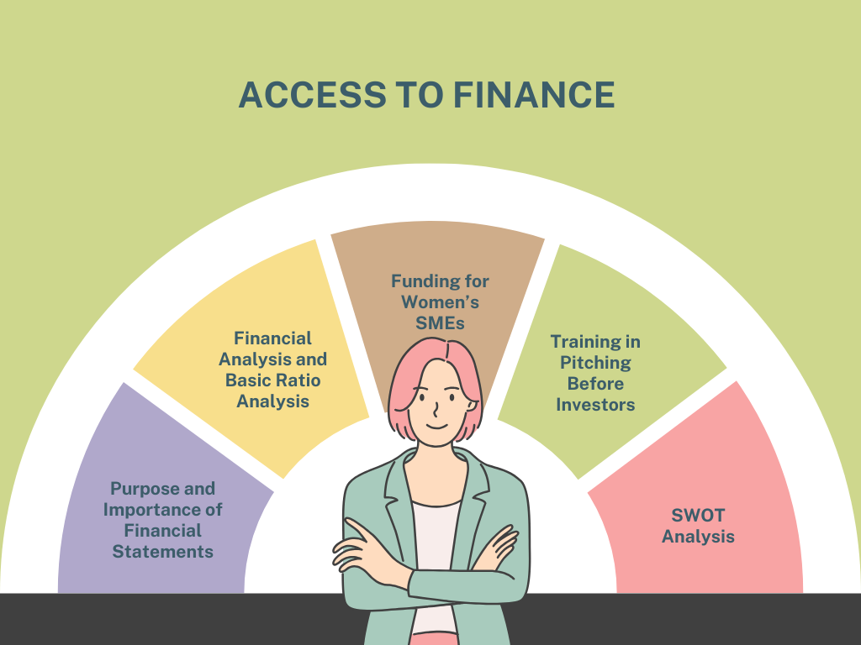
Company Performance Evaluation (Financial Analysis and Basic Ratio Analysis)
Figure 1 Key aspects of access to finance. Created by the author.

Slide 18
Liquidity Ratios
Liquidity: the ability of a firm to pay its short-term debts.
Liquidity ratios measure a company’s ability to meet short-term obligations. The current ratio, calculated as current assets divided by current liabilities, indicates the availability of resources to cover debts. A higher ratio suggests better liquidity, while a lower ratio signals potential financial strain.
The quick ratio (acid-test ratio) refines this analysis by excluding inventory from assets, focusing only on liquid resources. This is particularly useful for businesses in industries with slow-moving inventory. For women entrepreneurs, understanding these ratios is vital to maintaining operational stability and avoiding financial difficulties. Also known as the quick ratio, this is a stricter test of a firm’s liquidity. It ignores the least liquid of the firm’s current assets – inventories (stocks).
liquid assets
Acid-test ratio: current liabilities
Regularly monitoring liquidity ratios helps identify cash flow bottlenecks and ensures readiness to meet financial commitments. It also builds trust with lenders and suppliers, facilitating smoother business operations.

Slide 19
Credit Ratio
Credit ratios assess a company’s ability to handle its debt obligations. The debt-to-equity ratio compares total liabilities to shareholders' equity, reflecting the balance between borrowed funds and owner investments. A higher ratio may indicate financial risk but also highlights growth potential when managed effectively.
The interest coverage ratio measures how easily a business can pay interest on its debt using operating income. This ratio is critical for entrepreneurs seeking loans, as it reassures lenders about repayment capacity. Women entrepreneurs can leverage these insights to optimize borrowing strategies and negotiate favorable terms.
By understanding and applying credit ratios, businesses can achieve sustainable growth while maintaining financial stability.

Slide 20
Funding for women’s SMEs

Slide 21
Funding for Women’s SMEs
Innovation funding is crucial for empowering women entrepreneurs to drive growth in small and medium enterprises (SMEs). Grants, loans, and equity financing are popular options. Governments and international organizations often provide targeted programs to support women-led businesses in technology, sustainable development, and other innovative fields.
Securing funding requires a solid business plan that highlights the innovative aspect of the enterprise. This includes identifying a unique selling proposition, demonstrating market potential, and outlining the expected impact. Additionally, women entrepreneurs can benefit from incubators and accelerators that offer mentorship alongside funding opportunities.
Women entrepreneurs have multiple financing options available, each with unique benefits and challenges. The choice of funding method depends on the business model, growth stage, and financial needs. By understanding these funding sources, women entrepreneurs can develop a strategic approach to securing capital and building successful, sustainable businesses.
Securing financing is one of the most critical aspects of launching and growing a business. Women entrepreneurs face unique challenges in accessing capital, but there are various funding options available to support their ventures. These funding sources differ in terms of eligibility, repayment obligations, and the level of business control retained by the entrepreneur.

Slide 22
Funding for Women’s SMEs
THEORETICAL OVERVIEW OF THE KEY FINANCING METHODS.

Slide 23
Funding for women’s SMEs
GRANTS (NON-REPAYABLE FUNDS)
Grants are financial awards provided by governments, private organizations, or non-profits to support businesses without requiring repayment. They are typically awarded based on specific criteria, such as industry focus, social impact, or business ownership demographics (e.g., women-led businesses).
Key Characteristics:
No repayment required
Competitive application process
Often awarded for specific business purposes (e.g., innovation, social impact)
May have reporting requirements to show fund utilization
📌 Example: Government-backed grants for women entrepreneurs support economic empowerment by reducing financial barriers to business entry and expansion.

Slide 24
Funding for women’s SMEs
BUSINESS LOANS
A business loan is a form of debt financing in which an entrepreneur borrows capital from a financial institution, online lender, or government-backed program and repays it over time with interest. Loans provide a structured repayment schedule, but they require a solid credit history, business plan, and sometimes collateral.
Key Characteristics:
Requires repayment with interest
Can be secured (requires collateral) or unsecured (higher interest rates)
Can be short-term or long-term, depending on the business needs
Allows business owners to maintain full equity ownership
📌 Example: Microloans are a common financing method for small businesses, particularly in developing economies, providing low-interest capital to women entrepreneurs.

Slide 25
Funding for women’s SMEs
VENTURE CAPITAL (VC) AND ANGEL INVESTORS
Venture capital (VC) and angel investment involve external investors providing capital in exchange for equity (partial ownership) in the business. Venture capital firms typically invest in high-growth startups, while angel investors are individuals who provide early-stage funding.
Key Characteristics:
Provides significant funding for scaling businesses
Investors take an ownership stake and may influence decision-making
Suitable for high-growth, innovative startups
Requires a strong business plan and growth strategy
📌 Example: Tech startups often attract venture capital funding because they demonstrate high scalability and profitability potential.

Slide 26
Funding for women’s SMEs
CROWDFUNDING
Crowdfunding is a method of raising funds from a large number of people, usually through online platforms. It allows entrepreneurs to secure financing without traditional financial intermediaries, leveraging public interest and community support.
Key Characteristics:
Uses digital platforms to raise small amounts from many contributors
Can be reward-based (pre-selling products), equity-based (offering shares), or debt-based (repayable loans)
Ideal for product-based businesses and creative ventures
Requires strong marketing and audience engagement
📌 Example: Women-led businesses in fashion or technology often use Kickstarter to secure early-stage funding by offering pre-orders as rewards to backers.

Slide 27
Funding for women’s SMEs
BUSINESS COMPETITIONS AND ACCELERATORS
Entrepreneurial competitions and accelerators provide funding, mentorship, and networking opportunities to startups. Many of these programs focus on supporting women entrepreneurs by offering capital in exchange for participation in mentorship and training programs.
Key Characteristics:
Competitive selection process
Provides funding, mentorship, and networking opportunities
Often focused on innovation, technology, or social entrepreneurship
Some require partial equity in exchange for funding
📌 Example: The Cartier Women’s Initiative provides grants and mentorship to female entrepreneurs with businesses that have a social impact.

Slide 28
Funding for women’s SMEs
BOOTSTRAPPING (SELF-FUNDING)
Bootstrapping refers to funding a business using personal savings, reinvested profits, or revenue generated from early operations rather than seeking external financing. This method allows entrepreneurs to retain full ownership and control but may limit growth potential due to resource constraints.
Key Characteristics:
No debt or loss of equity
Requires financial discipline and careful budget management
Best for businesses that can generate revenue quickly
May limit expansion opportunities without external funding
📌 Example: Many small businesses start by bootstrapping, reinvesting early profits into growth before seeking external financing.

Slide 29
Training in Pitching Before Investors

Slide 30
Training in Pitching Before Investors
Pitching is an essential skill for entrepreneurs seeking investment. A successful pitch succinctly communicates the business idea, target market, revenue model, and growth potential. Women entrepreneurs can gain confidence by structuring pitches that emphasize innovation, financial sustainability, and social impact. Key components of an investor pitch include a compelling introduction, a problem-solution narrative, and a clear ask (investment amount and its purpose). Visual aids and data-driven arguments enhance credibility while rehearsing improves delivery and confidence.
Pitching to investors requires clear communication, strategic planning, and confidence. To increase the chances of securing funding, women entrepreneurs should go through structured training to refine their pitch and approach. By refining your pitch deck, mastering storytelling, engaging in mock pitching, and handling investor questions confidently, you can increase your chances of securing funding.

Slide 31
Training in Pitching Before Investors
A pitch deck is a short presentation (usually 10-12 slides) that highlights key business aspects. It should include:
Problem Statement – Clearly define the problem your business solves.
Solution & Unique Value Proposition – Explain how your product/service addresses the problem.
Market Opportunity – Show the market size and growth potential.
Business Model – Describe how you generate revenue.
Traction & Milestones – Present key achievements, customer acquisition, or revenue figures.
Competitive Advantage – Explain what differentiates you from competitors.
Go-To-Market Strategy – Outline your plan for acquiring customers.
Financial Projections – Provide realistic revenue and cost projections.
Funding Request – Clearly state how much funding you need and how you will use it.
Team – Highlight key team members and their expertise.

Slide 32
Explore the Concept of Net Working Capital to Manage Operational Finances Effectively

Slide 33
Explore the Concept of Net Working Capital to Manage Operational Finances Effectively
Net working capital (NWC) is the difference between current assets and current liabilities. It reflects the liquidity available for day-to-day operations. A positive NWC ensures smooth operations, while a negative one may signal cash flow challenges.
Managing NWC involves optimizing inventory levels, accelerating receivables, and extending payables without compromising supplier relationships. For women entrepreneurs, efficient NWC management is crucial for maintaining financial stability and supporting growth.
By regularly reviewing NWC, entrepreneurs can identify areas for improvement, ensure operational efficiency, and prepare for unforeseen financial needs.

Slide 34
Blockade Verification and Certifications Confirming the Settlement of Tax Obligations

Slide 35
Explore the Concept of Net Working Capital to Manage Operational Finances Effectively
Blockade verification involves checking whether a business is under financial constraints, such as frozen accounts or unresolved debts. This step is essential for maintaining transparency and credibility in financial dealings.
Certifications confirming tax settlements are equally important. They assure stakeholders that the business complies with tax regulations, avoiding legal issues. For women entrepreneurs, these certifications build trust with investors, lenders, and clients, facilitating smoother collaborations.
Adhering to these practices not only protects businesses from penalties but also enhances their reputation in competitive markets.

Slide 36
Creditworthiness Assessment

Slide 37
Creditworthiness Assessment
Creditworthiness assessment evaluates a business's ability to repay debts. It involves both quantitative and qualitative analyses. Quantitative aspects include examining financial ratios such as debt-to-equity and interest coverage, while qualitative aspects focus on business history, industry reputation, and management capabilities.
Women entrepreneurs must understand their credit profile to access financing effectively. Building a strong credit history involves timely repayment of debts, maintaining a good credit utilization ratio, and ensuring financial transparency.
This assessment is critical for negotiating favorable loan terms and establishing trust with lenders. Regular evaluations allow entrepreneurs to improve their creditworthiness and prepare for future growth opportunities.

Slide 38
Conduct an Assessment to Determine the Creditworthiness of Your Enterprise

Slide 39
Creditworthiness Assessment
Assessing creditworthiness begins with a thorough review of financial documents, such as balance sheets and cash flow statements. Entrepreneurs must ensure these records are accurate and up-to-date. Financial ratios, including liquidity and solvency measures, provide insight into the company’s financial health.
Qualitative factors, such as the stability of the management team and market reputation, are also considered. For women entrepreneurs, aligning personal credit history with business credit can enhance the overall evaluation.
Assessment of Creditworthiness:
• Importance of assessing creditworthiness for accessing financial resources.
• How to assess one's creditworthiness?
• Quantitative analysis
• Qualitative analysis
• Pitching presentation
By conducting regular assessments, businesses can identify areas for improvement, strengthen their financial standing, and gain access to a broader range of funding options.

Slide 40
Profitability Analysis

Slide 41
Creditworthiness Assessment
Profitability analysis measures a company’s ability to generate profit relative to its revenue, assets, and equity. Key metrics include gross profit margin, operating profit margin, and return on equity (ROE). These indicators reveal whether the business model is sustainable and efficient.
For women entrepreneurs, understanding profitability helps in identifying cost-saving opportunities and optimizing pricing strategies. Analyzing trends over time can highlight the success of initiatives and guide strategic planning.
Importance of Profitability Analysis for Women Entrepreneurs:
🚀 Access to Funding – Investors and lenders assess profitability before providing capital.
📊 Business Growth – Helps decide when to expand, hire staff, or invest in new products.
💰 Pricing & Cost Control – Ensures products/services are priced competitively while maintaining profitability.
👩‍💻 Financial Independence – A profitable business allows women entrepreneurs to reinvest and scale without relying on external financing.
Effective profitability analysis is crucial for securing investments, as it demonstrates the business’s potential for long-term growth. It also empowers entrepreneurs to make informed decisions that align with their financial goals.

Slide 42
Perform a Thorough Analysis of Your Company's Profitability

Slide 43
Perform a Thorough Analysis of Your Company's Profitability
To perform a comprehensive profitability analysis, begin by calculating profit margins and comparing them against industry benchmarks. This step helps identify whether the business is operating efficiently and competitively.
Next, evaluate cost structures, including fixed and variable expenses, to identify areas where costs can be reduced without compromising quality. Analyze product or service profitability to determine which offerings contribute the most to the bottom line.
For women entrepreneurs, regularly reviewing these metrics supports financial transparency and strengthens their position when seeking funding or partnerships. By optimizing profitability, businesses can achieve sustainable growth and enhance their market presence.

Slide 44
SWOT Analysis

Slide 45
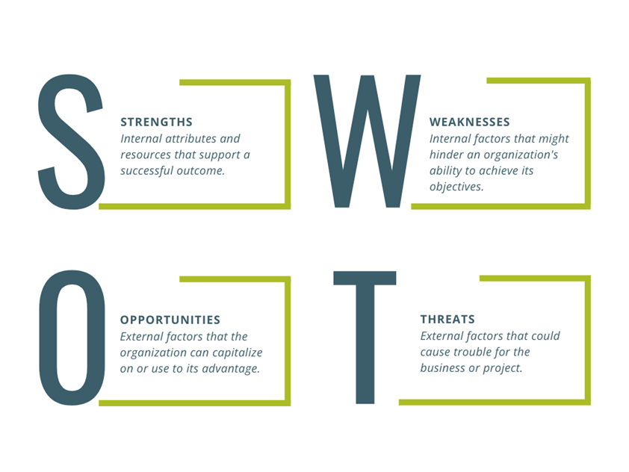
SWOT Analysis
SWOT Analysis is a simple but powerful tool that helps women entrepreneurs evaluate their business by identifying Strengths, Weaknesses, Opportunities, and Threats. It provides a clear picture of where the business stands and helps in strategic decision-making.
What Does SWOT Stand For?
Figure 2 SWOT Analysis. Created by the author.

Slide 46
SWOT Analysis
Category | Description | Examples
S – Strengths (Internal, Positive) | Advantages your business has over competitors, such as unique products, strong brand reputation, loyal customer base, skilled team, and efficient operations. | 📌 A woman entrepreneur running a handmade cosmetics business may have strong customer loyalty due to natural ingredients.
W – Weaknesses (Internal, Negative) | Areas where your business needs improvement, including limited financial resources, lack of brand awareness, dependence on a single supplier, and weak online presence. | 📌 A female-owned bakery may struggle with high ingredient costs, reducing profit margins.
O – Opportunities (External, Positive) | External factors your business can leverage for growth, such as increasing demand, new technology, government grants, and expansion to new markets. | 📌 A woman entrepreneur in fashion may find an opportunity in the growing demand for sustainable clothing.
T – Threats (External, Negative) | External challenges that could harm your business, including strong competition, economic downturns, changing customer preferences, and supply chain disruptions. | 📌 A woman running a local boutique may face threats from big online retailers offering lower prices.

Slide 47
SWOT Analysis
Why Is SWOT Analysis Important for Women Entrepreneurs?
✔ Helps in better decision-making
✔ Identifies areas for business improvement
✔ Guides in strategic planning
✔ Prepares the business to handle challenges
Conducting a SWOT analysis regularly ensures that strategies remain aligned with business goals. It fosters informed decision-making and equips entrepreneurs with a proactive approach to navigating challenges and seizing opportunities.

Slide 48
What to remember
Importance of Finance and Innovation: Critical for the growth, development, and success of women entrepreneurs.
Challenges:
Discrimination and Bias: Gender-based discrimination within financial institutions.
Lack of Collateral: Insufficient collateral to secure traditional loans.
Limited Financial Literacy: Gaps in understanding financial systems and products.
Awareness: Lack of knowledge about diverse financial products and services.
Creditworthiness: Stringent criteria that many women-owned businesses struggle to meet.
Policy Barriers: Inadequate policies and institutional support.
Network Access: Restricted access to professional networks.
Economic Instability: Disproportionate impact on women-owned businesses.
Support Systems: Importance of public and private initiatives, digital transformation, and strategic partnerships.
Advocacy: Need for advocating tailored financial options and capacity building.
Future Trends: Embrace technological integration, global collaboration, and ecosystem building for sustainable growth.

Slide 49
Self-assessment test
Why is access to finance and innovation crucial for the success of women entrepreneurs?
What is the main purpose of financial ratio analysis for women entrepreneurs?
Why is crowdfunding a popular financing method?
What does SWOT analysis help women entrepreneurs achieve?
To increase company expenses
To increase business costs
It allows businesses to raise funds from multiple contributors online
Ignore external business threats
To avoid legal regulations
To assess profitability, liquidity, and leverage for better decision-making
It eliminates the need for financial planning
Identify strengths, weaknesses, opportunities, and threats
To achieve growth, development, and success
To attract competitors
It guarantees funding without investor scrutiny
Increase reliance on personal savings

Slide 50
Self-assessment test - correct answers

Slide 51
Self-assessment test
Why is access to finance and innovation crucial for the success of women entrepreneurs?
What is the main purpose of financial ratio analysis for women entrepreneurs?
Why is crowdfunding a popular financing method?
What does SWOT analysis help women entrepreneurs achieve?
To increase company expenses
To increase business costs
It allows businesses to raise funds from multiple contributors online
Ignore external business threats
To avoid legal regulations
To assess profitability, liquidity, and leverage for better decision-making
It eliminates the need for financial planning
Identify strengths, weaknesses, opportunities, and threats
To achieve growth, development, and success
To attract competitors
It guarantees funding without investor scrutiny
Increase reliance on personal savings

Slide 52
The Innovation segment of the Module includes the following sub-topics:

Slide 53
Creative thinking skills

Slide 54
CREATIVE THINKING SKILLS
According to Gildi Waisburd, the expert on creativity, key traits of creative people are: flexibility, curiosity, independence, reflection (thinking about what they see and hear), ability to concentrate, perseverance, commitment, sense of humour, ability to overcome difficult situations and conflicts, can see the whole picture, have a list of ideas for a solution to a problem, like to "play" with things, understand the needs of others, set out in detail their task, can tell a story-storytelling.

Slide 55
CREATIVE THINKING SKILLS- A Creative Approach to Innovation
Objective: Teach participants how to unlock their creative potential and generate innovative ideas.
Key Topics:
Mindset for Creativity (Growth Mindset, Overcoming Mental Barriers)
Divergent vs. Convergent Thinking
Techniques: Brainstorming, SCAMPER, Mind Mapping, 6 Hats, "How Might We?"
Exercise 1 – Group Work: Design Thinking & Creative Thinking Skills
Design Thinking enhances creative problem-solving by focusing on empathy, user needs, and iterative prototyping. It involves:
Empathy – Understanding users’ needs deeply.
Defining the Problem – Clearly framing challenges from a human-centred perspective.
Ideation – Brainstorming and generating diverse solutions.
Prototyping – Quickly developing models to test concepts.
Testing & Refining – Gathering feedback and improving solutions.
It shifts thinking from "What can we create?" to "What does the user really need?"

Slide 56
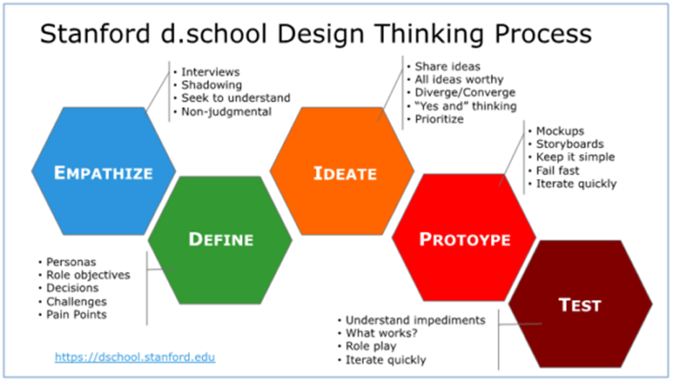
CREATIVE THINKING SKILLS- A Creative Approach to Innovation
Figure 3 Stanford d.school Design Thinking Process

Slide 57
Design Of The Strategic Plan For Innovation

Slide 58
Design Of The Strategic Plan For Innovation
Designing the Strategic Plan for Innovation – From Ideas to Strategy
Objective: Guide participants in structuring innovative ideas into a strategic framework. Key Topics:
Elements of a Strategic Innovation Plan
SWOT, PESTLE & Trend Analysis for Innovation
Setting Innovation Goals & Metrics
Tools: Job to be Done, Value Proposition, Business Model Canvas, Innovation Roadmap

Slide 59
Design Of The Strategic Plan For Innovation
Exercise 2 - Group Work: Draft a Mini Innovation Strategy for a selected company
Participants explore successful innovations and develop strategic action plans for their imagined businesses.
The exercise includes:
Brainstorming innovative solutions to business challenges
Crafting personal action plans for implementing innovations
Developing and pitching strategic innovation plans (3–5 minutes) for funding consideration
Groups vote on the best innovation, and winners are rewarded. The post-presentation discussion involves critical feedback on the innovation's strengths and areas for improvement. The competitive nature of the exercise highlights the importance of quantitative analysis, qualitative feedback, and effective presentations in securing funding.

Slide 60
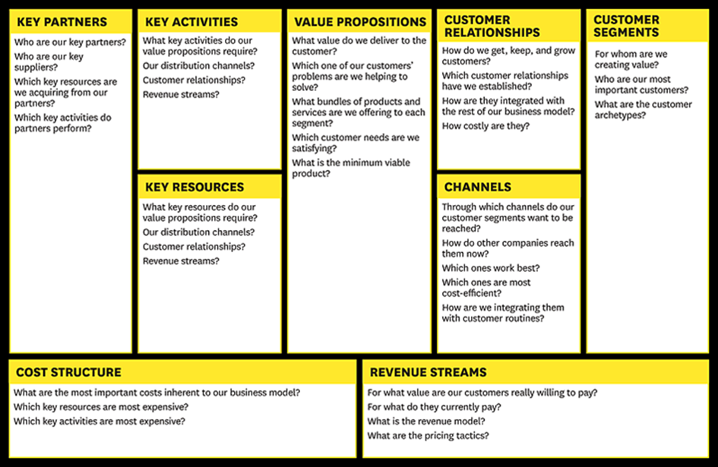
Design Of The Strategic Plan For Innovation
How to draft Innovation Strategy:
Define Vision, Mision, Values
Set Clear Goals & KPIs & Measuring Success
Discover Job to be Done, Pain Gain Model
Define Value Proposition,
Create Canvas Business Model
Figure 4 Business Model Canvas

Slide 61
Design Of The Strategic Plan For Innovation
Objective: Equip participants with tools to turn strategies into action and ensure success.
Key Topics:
Overcoming Resistance to Change
Change Management process
Leadership & Team Alignment for Innovation Execution
Christensen, C. (1997) and Zhexembayeva, N. (2021) explained the phenomenon of Corporate Narcissism or "We're too good to fail" by describing why large organizations fail to engage in the innovation process: "The decision-making and resource allocation processes that are critical to success organization is the art of listening to customers, carefully monitoring the activities of competitors, and investing resources in designing and building high-quality, high-performance products that will bring more profit. These are the reasons why large organizations failed when faced with disruptive technological changes."

Slide 62
Effective Implementation Of Innovative Ideas

Slide 63
Effective Implementation Of Innovative Ideas
Objective: Equip participants with tools to turn strategies into action and ensure success.
Key Topics:
Overcoming Resistance to Change
Change Management process
Leadership & Team Alignment for Innovation Execution

Slide 64
Effective Implementation Of Innovative Ideas
Clayton Christensen (The Innovator's Dilemma, 1997), and Nadya Zhexembayeva (Overfished Ocean Strategy: Powering Up Innovation for a Resource-Deprived World, 2021) explained the phenomenon of Corporate Narcissism or "We're Too Good to fail" by describing why large organizations fail to engage in the innovation process: "The decision-making and resource allocation processes that are critical to success organization is the art of listening to customers, carefully monitoring the activities of competitors, and investing resources in designing and building high-quality, high-performance products that will bring more profit. These are the reasons why organizations fail when faced with disruptive technological changes."
According to Mamula Nikolić, T. (2023), several questions arise - how can we reinvent a business, its processes, business model, and brand, considering the rapid changes in the environment? How can we respond to the demands of consumers, employees, suppliers, business partners, society, and increasingly strong competition?

Slide 65
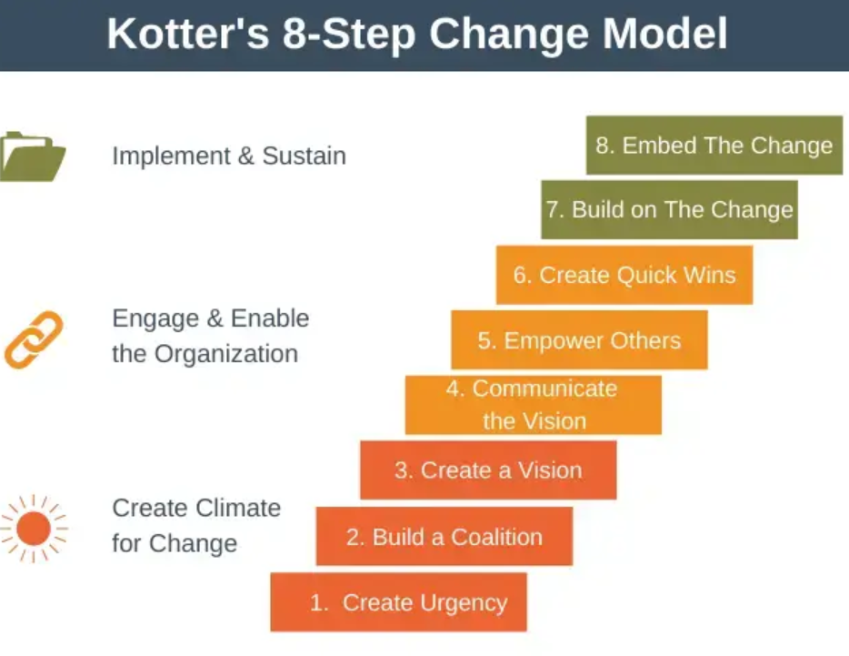
Effective Implementation Of Innovative Ideas
Exercise 3 - Group Work: Create a roadmap for implementing an innovative idea within their organization and a special focus on the change management process according to Kotter.
Figure 5 Kotter's 8-step Change Model

Slide 66
Quick Self-Assessment test of Innovation capacity for SMEs based on INNOVATE

Slide 67
I. Product Development Strategy:
Business Strategy
Strategic planning, defining the mission, vision, and/or clear business focus. Regular preparation of annual plans, analysis of new markets and products
Products and Markets
Understanding of competition, awareness of market needs for your product, assortment planning, etc
Technology and production
How much does the company track technological changes, and how much effort and resources are invested in improving design, technology, and business processes?
Customer focus
To what extent do the company's products/services meet customer needs? Are customer requirements defined before developing a new product? Awareness of laws regulating the market for specific products/services (existence, permits, standards) ...
Quality
The existence of quality standards, adherence to quality practices and procedures throughout the company in accordance with ISO 9000, presence of quality control in the business system (in which segments), the existence of a TQM (Total Quality Management) program aimed at continuous improvement of development, production, sales, and service activities. Ability to quantify costs of quality/failure.
Intellectual property rights
To what extent does the company pay attention to intellectual property protection when developing a new product? Does it have resources for intellectual property protection?

Slide 68
II. Structured product development
How to create a structure of the product development process, aiming for the rapid realization of the project and maintaining control over the process implementation?
Defined process (to what extent is the product development procedure present and is it present at all? Is each product developed differently? Procedures exist but are simple, and controlled through meetings; the product development process is clear and defined by the Official Control Manual for all phases of the process; there is complete tracking of product status in each phase of the process
Organization (Is there a developed line of responsibility in product development management or is only one manager responsible for the entire process?)
Level of implementation (To what extent are there plans for various types of development projects, decisions are made on an ad hoc basis regarding which processes will accompany which project; are there and to what extent are there rules for various types of projects from major developments to simple adaptations; does the entire company understand the process; are clear criteria for the process that accompanies each project; performance measurement is used for continuous improvement).

Slide 69
II. Structured Product Development
Performance measurement Is there quantitative performance measurement for product development? project's impact known at the end of the fiscal year or not; are performance regularly measured in each phase of the process or not
Initial project assessment How thoroughly are initial assessments of development production costs conducted and compared with sales prices and quantities; to what extent is fully integrated marketing, development, and production evaluation present before any project is approved?

Slide 70
III. Team Work
How people work together in a team and how successful they are in developing a new product: team selection, organization and functioning?
Team composition
Roles and responsibilities
Training and qualifications
Management and motivation
Communication

Slide 71
IV. Tools And Techniques
Availability and application of appropriate tools and techniques such as CAD, SPC, FMEA, in all stages of the product design process, to maximize the effectiveness of the development team
Application
Quality improvement tools
Cost reduction tools
Information technology
Planning tools
Product testing and evaluation

Slide 72
V. Parallel Work (On Several Aspects Of The Project)
Market, product, process, materials
Product price
Available information
Supply chain partnership

Slide 73
VI. Project And Program Management
How projects and groups of projects are managed to ensure efficient resource allocation;
eliminate conflicts and bottlenecks in the process;
control costs;
adhere to activity schedules

Slide 74
Thank you for your attention!

